Slide 1

Einstein Vision
Group 12
Team Members:
Abhijeet Sanjay Rathi
Anuj Jagetia
Notes:
Cover for a full photo background

Slide 2
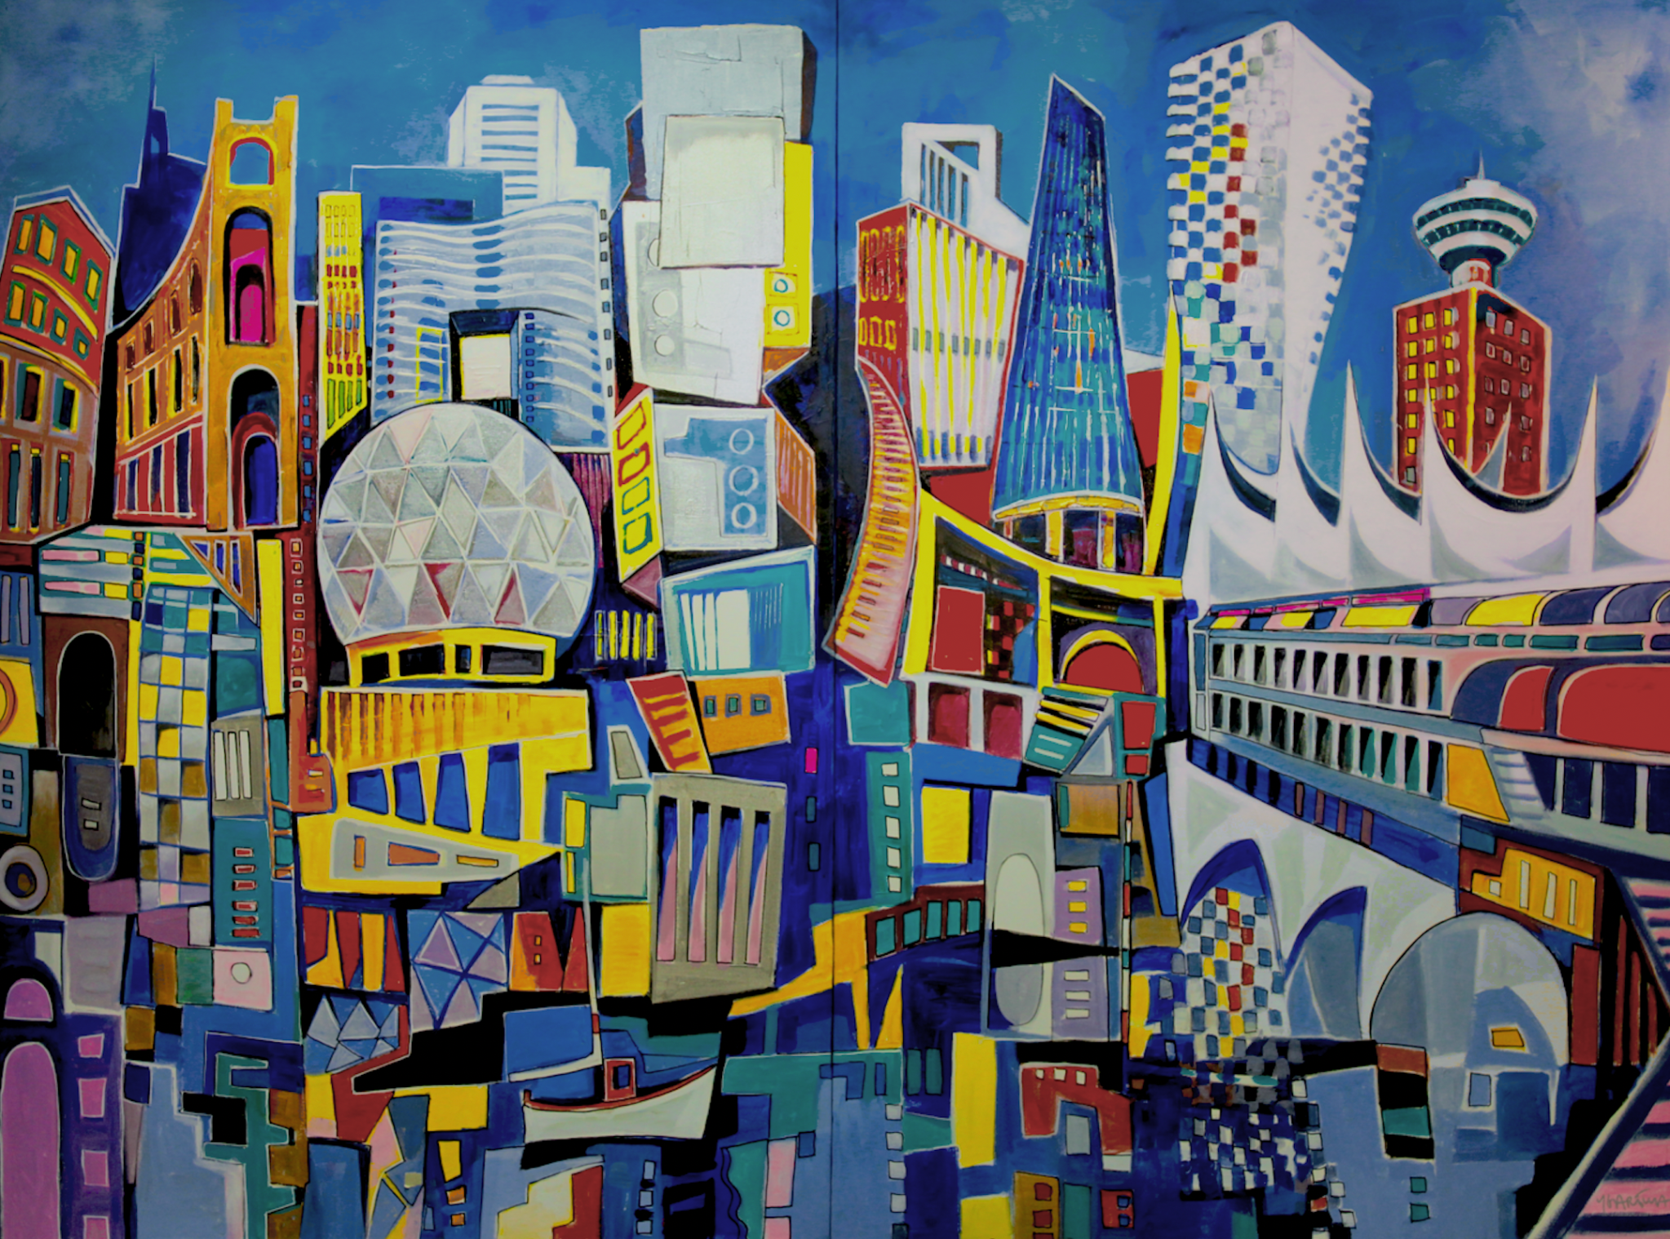
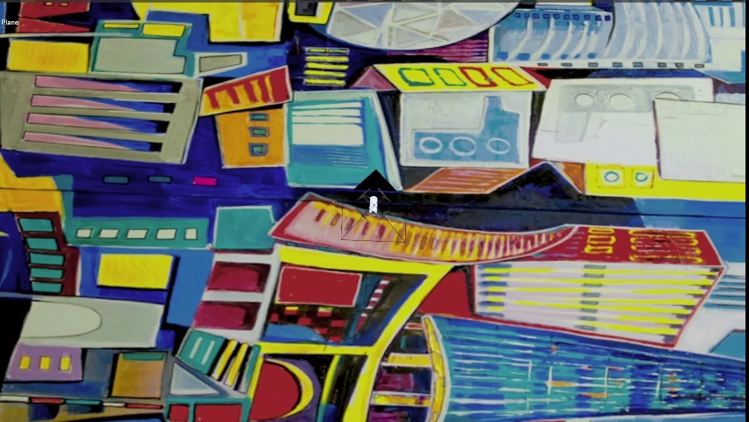
Data Generation

Slide 3
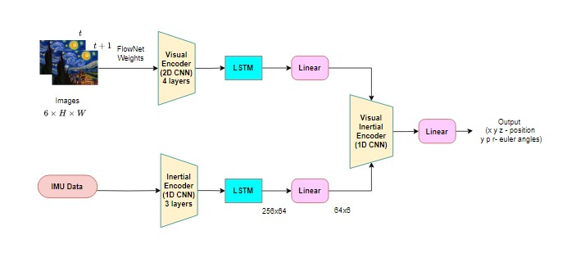
Network Architecture

Slide 4

Failures Cases
Not Enough Trajectory
Orientation error
Constant Learning Rate
Data Generation with gnss repository

Slide 5
Conclusion and Future Scope
Novel Deep Learning Architecture
Promising Results
Learning Under Uncertainty
Data Efficiency and Semi-supervised Learning
Network Architecture Innovations

Slide 6
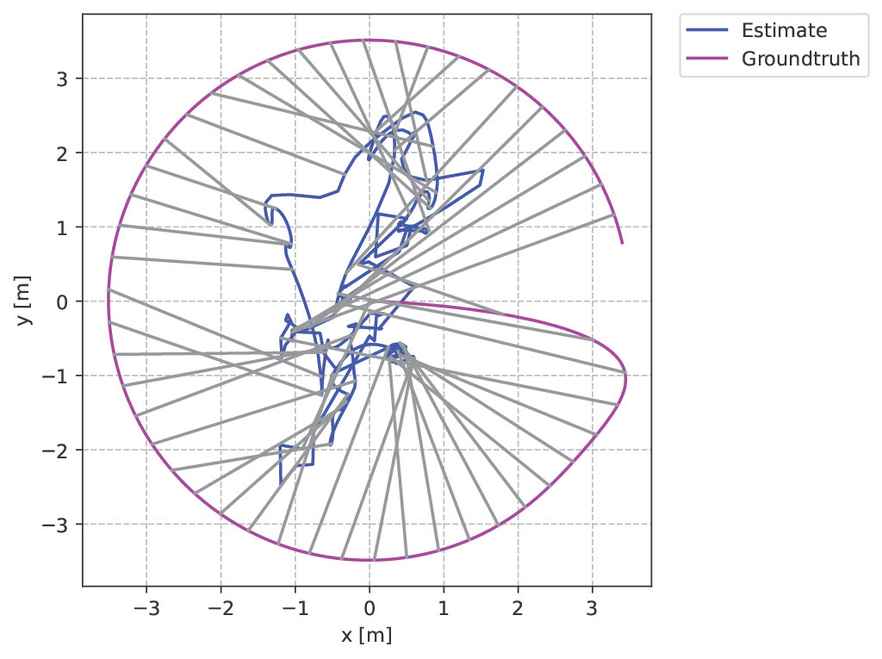
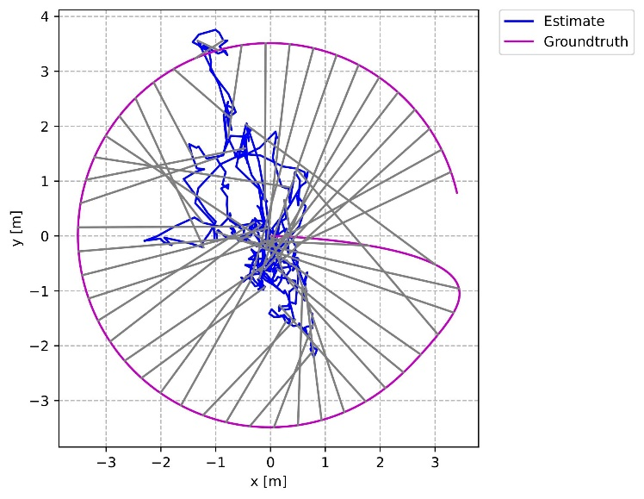
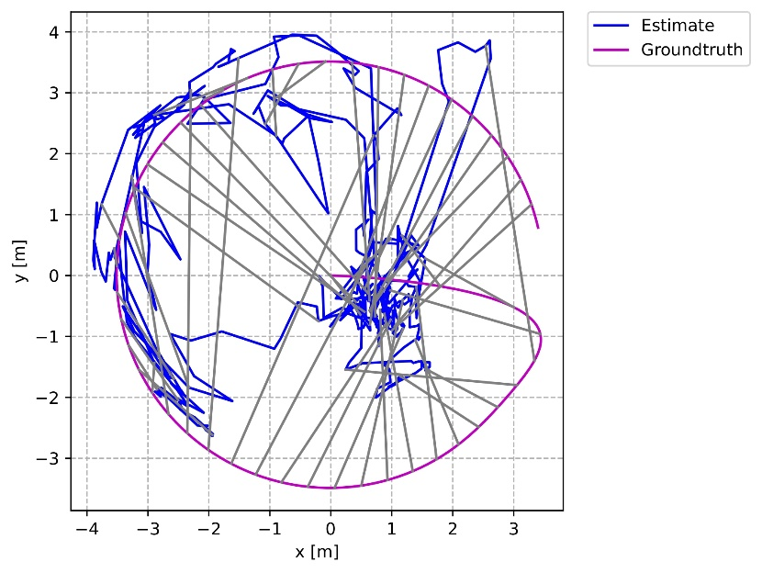
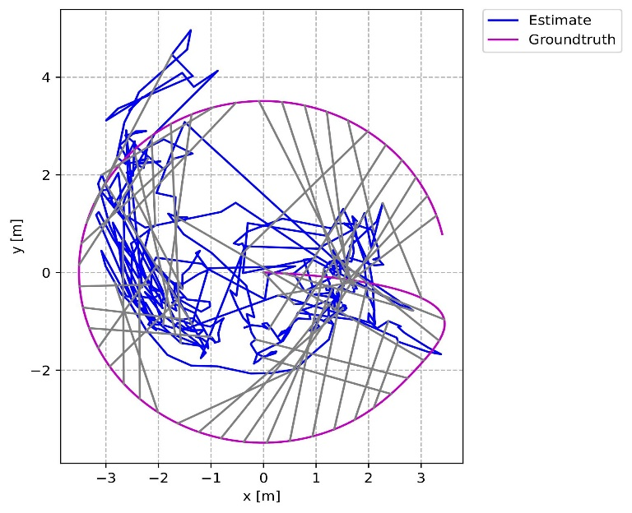
Results
Test case for Inertial
Test case for Visual
Circle
Test case for SGD Optimizer
Test case for AdamW Optimizer

Slide 7
Thank You

